Slide 1
Introduction to Web Services
420-C50 S16
Notes:
Roger Wolter Microsoft Corporation

Slide 2
Web Services
A Web service is an application that:
Runs on a Web server
Exposes Web methods to interested callers
Listens for HTTP requests representing commands to invoke Web methods
Executes Web methods and returns the results

Slide 3
What Is an XML Web Service?
Expose useful functionality to Web users through a standard Web protocol
In most cases, the protocol used is SOAP or REST
Provide a way to describe their interfaces in enough detail to allow a user to build a client application to talk to them
This description is usually provided in an XML document called a Web Services Description Language (WSDL) document

Slide 4
What Is an XML Web Service?
XML Web services are registered so that potential users can find them easily
This is done with Universal Discovery Description and Integration (UDDI)

Slide 5
Why use Web Services?
They allow programs written in different languages on different platforms to communicate with each other in a standards-based way
XML Web services work with standard Web protocols—XML, HTTP and TCP/IP
A significant number of companies already have a Web infrastructure, and people with knowledge and experience in maintaining it

Slide 6
What can I do with XML Web services?
The first XML Web services tended to be information sources that you could easily incorporate into applications
Stock quotes, weather forecasts, sports scores etc.
Most of this information is available on the Web
XML Web services make programmatic access to it easier and more reliable

Slide 7
What can I do with XML Web services?
Might develop a purchasing application to
automatically obtain price information from a variety of vendors,
allow the user to select a vendor,
submit the order
and then track the shipment until it is received

Slide 8
What can I do with XML Web services?
The vendor application, in addition to exposing its services on the Web,
might in turn use XML Web services to check the customer's credit,
charge the customer's account
and set up the shipment with a shipping company
Business-to-business (B2B) transactions are common uses for web services

Slide 9
SOAP
The communications protocol for XML Web services
A specification that defines the XML format of messages
If you have a well-formed XML fragment enclosed in a couple of SOAP elements, you have a SOAP message

Slide 10
SOAP – Major Parts
Envelope
Wrapper that holds everything together
Specifies XML namespace(s) to be used
Body
Makes the call to the service and sends the values

Slide 11
HTTP Request with SOAP Envelope
POST /calc.asmx HTTP/1.1 Host: www.somewhere.com
Content-Type: text/xml; charset=utf-8 Content-Length: 338
SOAPAction: "http://tempuri.org/Add"
<?xml version="1.0" encoding="utf-8"?>
<soap:Envelope
xmlns:xsi="http://www.w3.org/2001/XMLSchema-instance" xmlns:xsd="http://www.w3.org/2001/XMLSchema" xmlns:soap= " http://schemas.xmlsoap.org/soap/envelope/ ">
<soap:Body>
<Add xmlns="http://www.somewhere.com/calc">
<a>2</a>
<b>2</b>
</Add>
</soap:Body>
</soap:Envelope>

Slide 12
HTTP Response
HTTP/1.1 200 OK
Content-Type: text/xml; charset=utf-8
Content-Length: 353
<?xml version="1.0" encoding="utf-8"?>
<soap:Envelope
xmlns:xsi="http://www.w3.org/2001/XMLSchema-instance"
xmlns:xsd="http://www.w3.org/2001/XMLSchema"
xmlns:soap="http://schemas.xmlsoap.org/soap/envelope/">
<soap:Body>
<AddResponse xmlns="http://www.somewhere.com/calc">
<AddResult>4</AddResult>
</AddResponse>
</soap:Body>
</soap:Envelope>

Slide 13
Optional Parts of SOAP
How to represent program data as XML
SOAP supports document style applications where the SOAP message is just a wrapper around an XML document.
Document-style SOAP applications are very flexible and many new XML Web services take advantage of this flexibility to build services

Slide 14
Optional Parts of SOAP – HTTP
Defines what an HTTP message that contains a SOAP message looks like.
HTTP binding is important because HTTP is supported by almost all current OS's
Transforms data from HTTP format to format understood by OS
The HTTP binding is optional, but almost all SOAP implementations support it because it's the only standardized protocol for SOAP

Slide 15
Optional Parts of SOAP – HTTP
Since HTTP is a core protocol of the Web, most organizations have a network infrastructure that supports HTTP and people who understand how to manage it already
The security, monitoring, and load-balancing infrastructure for HTTP are readily available today

Slide 16
Advantages of SOAP
Best feature of SOAP is that it has been implemented on many different hardware and software platforms
This means that SOAP can be used to link different systems inside and outside an organization

Slide 17
Advantages of SOAP
SOAP, however, can use existing XML Parsers and HTTP libraries to do most of the hard work
Makes SOAP implementation easier
HTTP is everywhere and SOAP is simple
Makes them ideal basis for implementing XML Web services that can be called from almost any environment

Slide 18
WSDL
WSDL (often pronounced whiz-dull) stands for Web Services Definition Language.
A WSDL file is an XML document that describes a set of SOAP messages and how the messages are exchanged
Since WSDL is XML, it is readable and editable but in most cases, it is generated and consumed by software.

Slide 19
Why Use WSDL
To see the value of WSDL, imagine you want to start calling a SOAP method provided by one of your business partners
You could ask him for some sample SOAP messages and write your application to produce and consume messages that look like the samples, but this can be error-prone

Slide 20
Why Use WSDL
For example, you might see a customer ID of 2837 and assume it's an integer when in fact it's a string
WSDL specifies what a request message must contain and what the response message will look like in unambiguous notation

Slide 21
WSDL Format
The notation that a WSDL file uses to describe message formats is based on the XML Schema standard
Means it is both programming-language neutral and standards-based
Makes it suitable for describing XML Web services interfaces that are accessible from a wide variety of platforms and programming languages

Slide 22
Other Features of WSDL
WSDL defines where the service is available and what communications protocol is used to talk to the service
WSDL file defines everything required to write a program to work with an XML Web service

Slide 23
WSDL Tools
There are several tools available to read a WSDL file and generate the code required to communicate with an XML Web service.
Some of the most capable of these tools are in Microsoft Visual Studio® .NET.
Many current SOAP toolkits include tools to generate WSDL files from existing program interfaces

Slide 24
UDDI
Universal Discovery Description and Integration is the yellow pages of Web services.
As with traditional yellow pages, you can:
Search for a company that offers the services you need;
Read about the service offered; and
Contact someone for more information.
You can offer a Web service without registering it in UDDI, but…
if you want to reach a significant market, you need UDDI so your customers can find you

Slide 25
UDDI directory
A UDDI directory entry is an XML file that describes a business and the services it offers
There are three parts to an entry in the UDDI directory.
The "white pages" describe the company offering the service: name, address, contacts, etc
The "yellow pages" include industrial categories based on standard taxonomies such as the North American Industry Classification System and the Standard Industrial Classification
The "green pages" describe the interface to the service in enough detail for someone to write an application to use the Web service

Slide 26
UDDI directory
The UDDI directory also includes several ways to search for the services you need
For example, you can search for providers of a service
in a specified geographic location
or for business of a specified type
The UDDI directory will then supply information, contacts, links, and technical data to allow you to evaluate which services meet your requirements

Slide 27
Using GET and POST Commands
Web services written with the .NET Framework also allow their Web methods to be invoked using ordinary HTTP GET and POST commands.
Get command
GET /Services/Calculator/Version1/Calculator.asmx/Add?a=3&b=2 HTTP/1.1
Host: www.html2xml.nl

Slide 28
Response to GET
HTTP/1.1 200 OK
Content-Type: text/xml; charset=utf-8
Content-Length: length
<?xml version="1.0" encoding="utf-8"?>
<int xmlns="http://tempuri.org/">5</int>

Slide 29
POST Command
POST /Services/Calculator/Version1/Calculator.asmx/Add HTTP/1.1 Host: www.html2xml.nl Content-Type: application/x-www-form-urlencoded
Content-Length: 7
a=2&b=3

Slide 30
Response to POST
HTTP/1.1 200 OK Content-Type: text/xml; charset=utf-8
Content-Length: length
<?xml version="1.0" encoding="utf-8"?>
<int xmlns="http://tempuri.org/">5</int>

Slide 31
Class Activity
Go to http://www.webservicex.net or http://csdev.cegep-heritage.qc.ca/students/rchan/C50/SampleServices/Cities.asmx
it’s a bunch of sample web services you can play with.
Pick a service. Explore:
Demo page
Inputs
Outputs
WSDL
Create a new .NET MVC project
Add your new service
right click in Solution Explorer; add->Service Reference
Paste in the WSDL URL; be sure to fill in the namespace you’d like to use
Note the new Service Reference folder in your Solution Explorer
Note the new bindings in your Web.config file

Slide 32
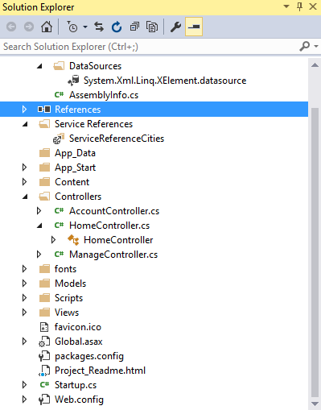
Class Activity –Step by Step
Create a new .NET MVC project
Right click on References -> Add Service Reference
Address: http://csdev.cegep-heritage.qc.ca/students/rchan/C50/SampleServices/Cities.asmx?WSDL
Select “Go”
Cities service is discovered
Set namespace to “ServiceReferenceCities”
Magically, VS goes out, using the WSDL, but build a local proxy

Slide 33
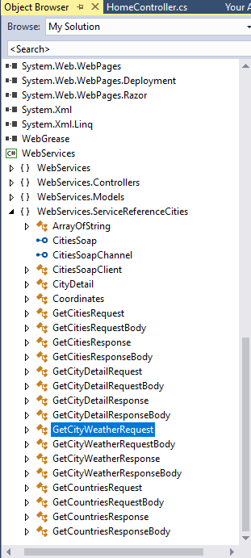
Class Activity –Step by Step
What did we get? Double click on ServiceReferenceCities in the Solution Explorer
Free methods to call that abstract web services!
How can you say no to Free methods?!

Slide 34
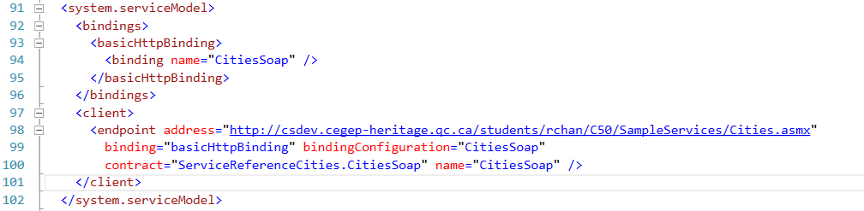
Class Activity –Step by Step
Note the reference automatically added in web.config by the Visual Studio tools
Take a look at WebServices.ServiceReferenceCities.CitiesSoap for methods.

Slide 35
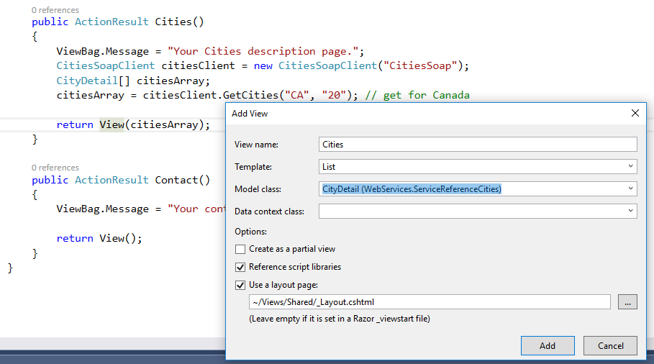
Class Activity –Step by Step
Build a controller method and a view to list
Hardcoded for now
Notes:
Note: leave Data context class blank (wrong in screenshot)

Slide 36
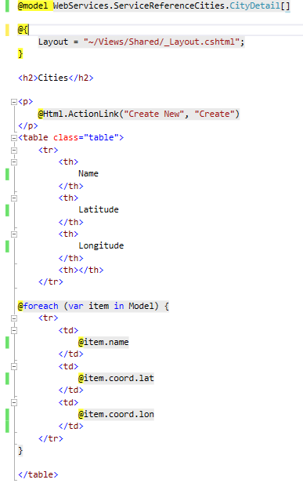
Class Activity –Step by Step
A little custom work in the view
Notes:
Note: leave Data context class blank (wrong in screenshot)

Slide 37
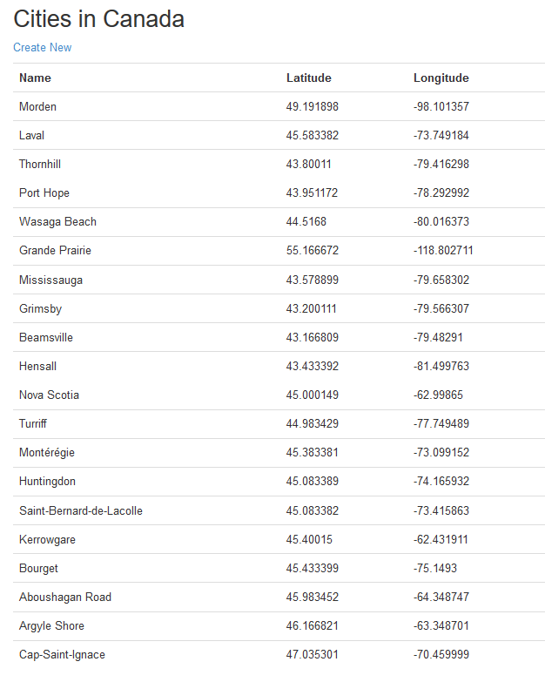
Class Activity –Step by Step
Le voilà
Notes:
Note: leave Data context class blank (wrong in screenshot)

Slide 38
Class Activity
Make it look nice
Allow user input, collect from view
Call service from controller and handle the results
You may optionally wrap the service in a thin model
JsonResult return type
New controller action to return a JsonResult

Slide 39

Class Activity – post activity
Consider what you’ve done:
.NET automatically learns of all the offerings of a service given the WSDL.
It learnt the methods, parameters and types!
You can call this service as simply as a regular function.
It is abstracting serializing, sending, receiving, deserialing for you!
How cool is that?!
Notes:
Note: the string in the SoapClient constructor is the channel label that must match what’s in the Web.config file. It tells the object which protocol/channel it is to use.

